Slide 1


Introduction to Competitive Programming
Week 6: Graphs
Notes:
https://join.slack.com/t/introductiont-c5a2137/shared_invite/zt-djtdwpqu-S_tju9SZhk2IKhcYICitCQ

Slide 2
1.
Introduction

Slide 3
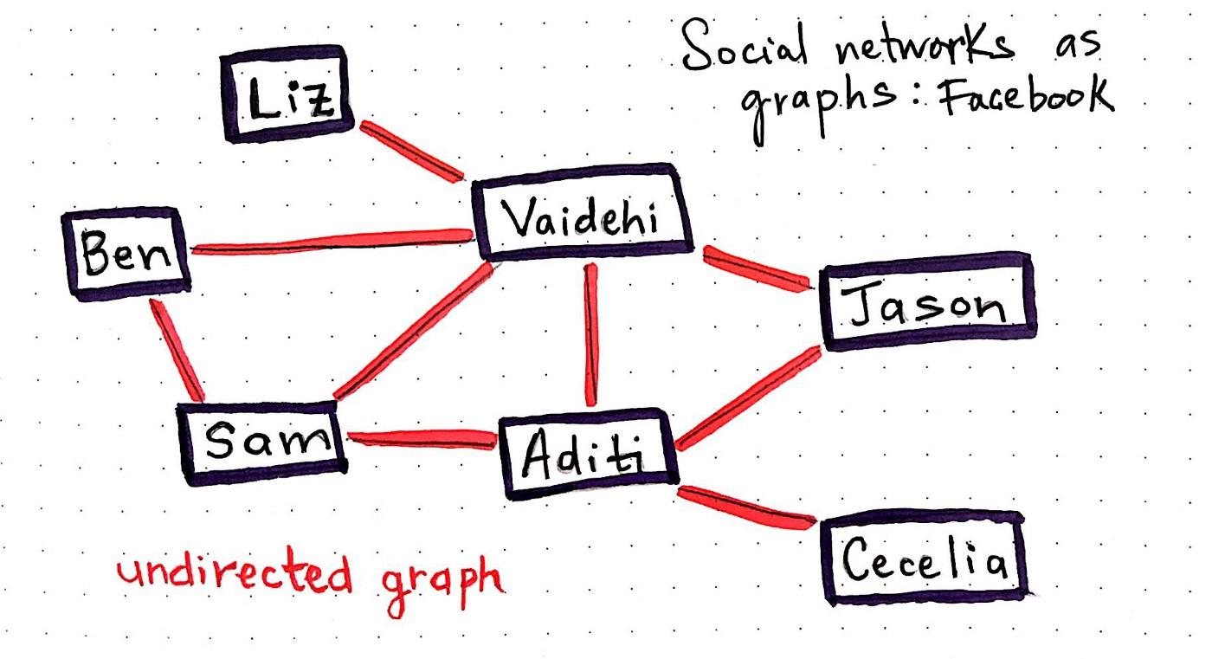
Graphs
Graphs
A formal way to represent a network of interconnected objects
G = (V, E)
V = set of vertices or nodes
E = set of edges (connectors between nodes)
Use cases: Maps, Facebook vs. Instagram, Internet
Path finding, network connectivity etc.

Slide 4
Terminology
Paths
Leads from a node to another node through the edges of the graph
The length of a path is the number of edges in it
A cycle is a path where the first and last node is the same.
Connectivity
Connected if there is a path between any two nodes
Neighbors if there is an edge between them.

Slide 5
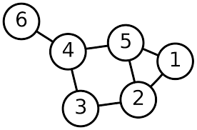
Representation
Adjacency Lists
Adjacent = Neighbor
List of neighbors for each node
1: 2, 5
2: 1, 3, 5
3: 2, 4
4: 3, 5, 6
5: 1, 2, 4
6: 4

Slide 6
2.
Traversal

Slide 7
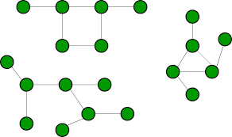
Traversal?
Given a starting node in the graph, a traversal algorithm visits all nodes that can be reached from the starting node
BFS (today), DFS (next week, along with trees)
Useful for questions such as…
How many connected components are there?
What is the shortest path between node A and node B?
How many people am I “related” to on Facebook?
May seem simple visually, but computers can’t see!*

Slide 8
Breadth-First Search
Breadth-first search (BFS) visits the nodes of a graph in increasing order of their distance from the starting node
First the search explores the nodes whose distance from the starting node is 1, then the nodes whose distance is 2, and so on. This process continues until all nodes have been visited

Slide 9
Breadth-First Search
Breadth-first search (BFS) gives us the length of the shortest path from a node to all other nodes it can reach!
Implemented with a queue
Jupyter!

Slide 10
3.
Problems

Slide 11
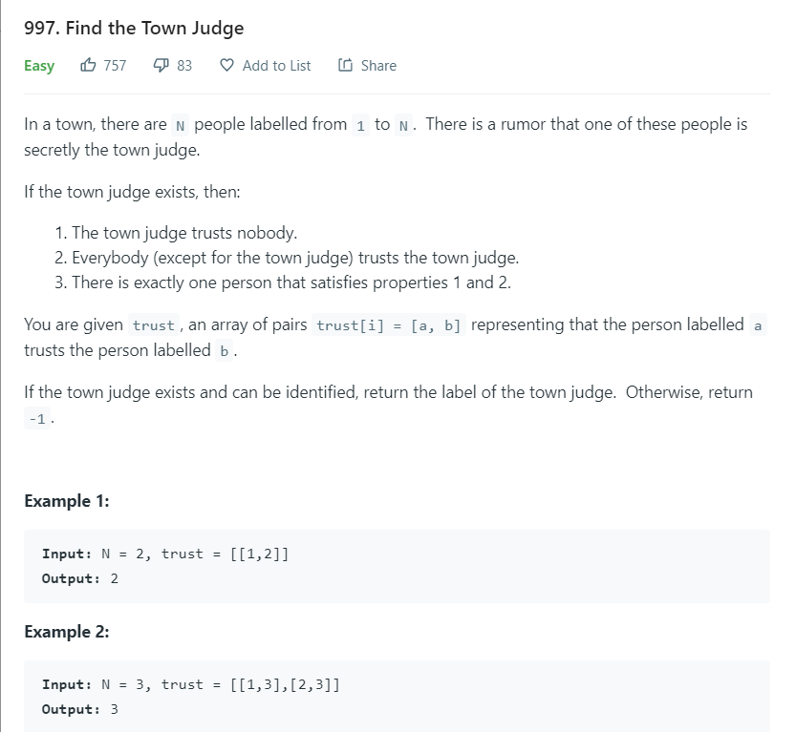
Practice 1

Slide 12
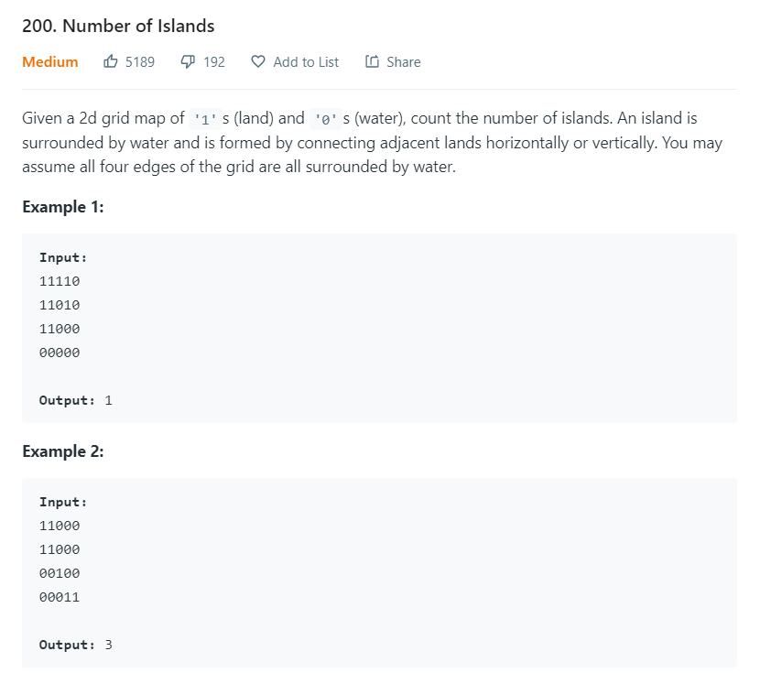
Practice 2

Slide 13
4.
Endnotes

Slide 14
Homework
Week 6: Graphs!
Collected (email me! < 24 hrs)
Bug fixing, optimization, concerns
Highly encouraged
4-5 / week
Leetcode

Slide 15
5.
Python!

